Slide 1
INALT20X Modal Decomposition
Annual and semi-annual harmonic for baroclinic mode 1-5

Slide 2
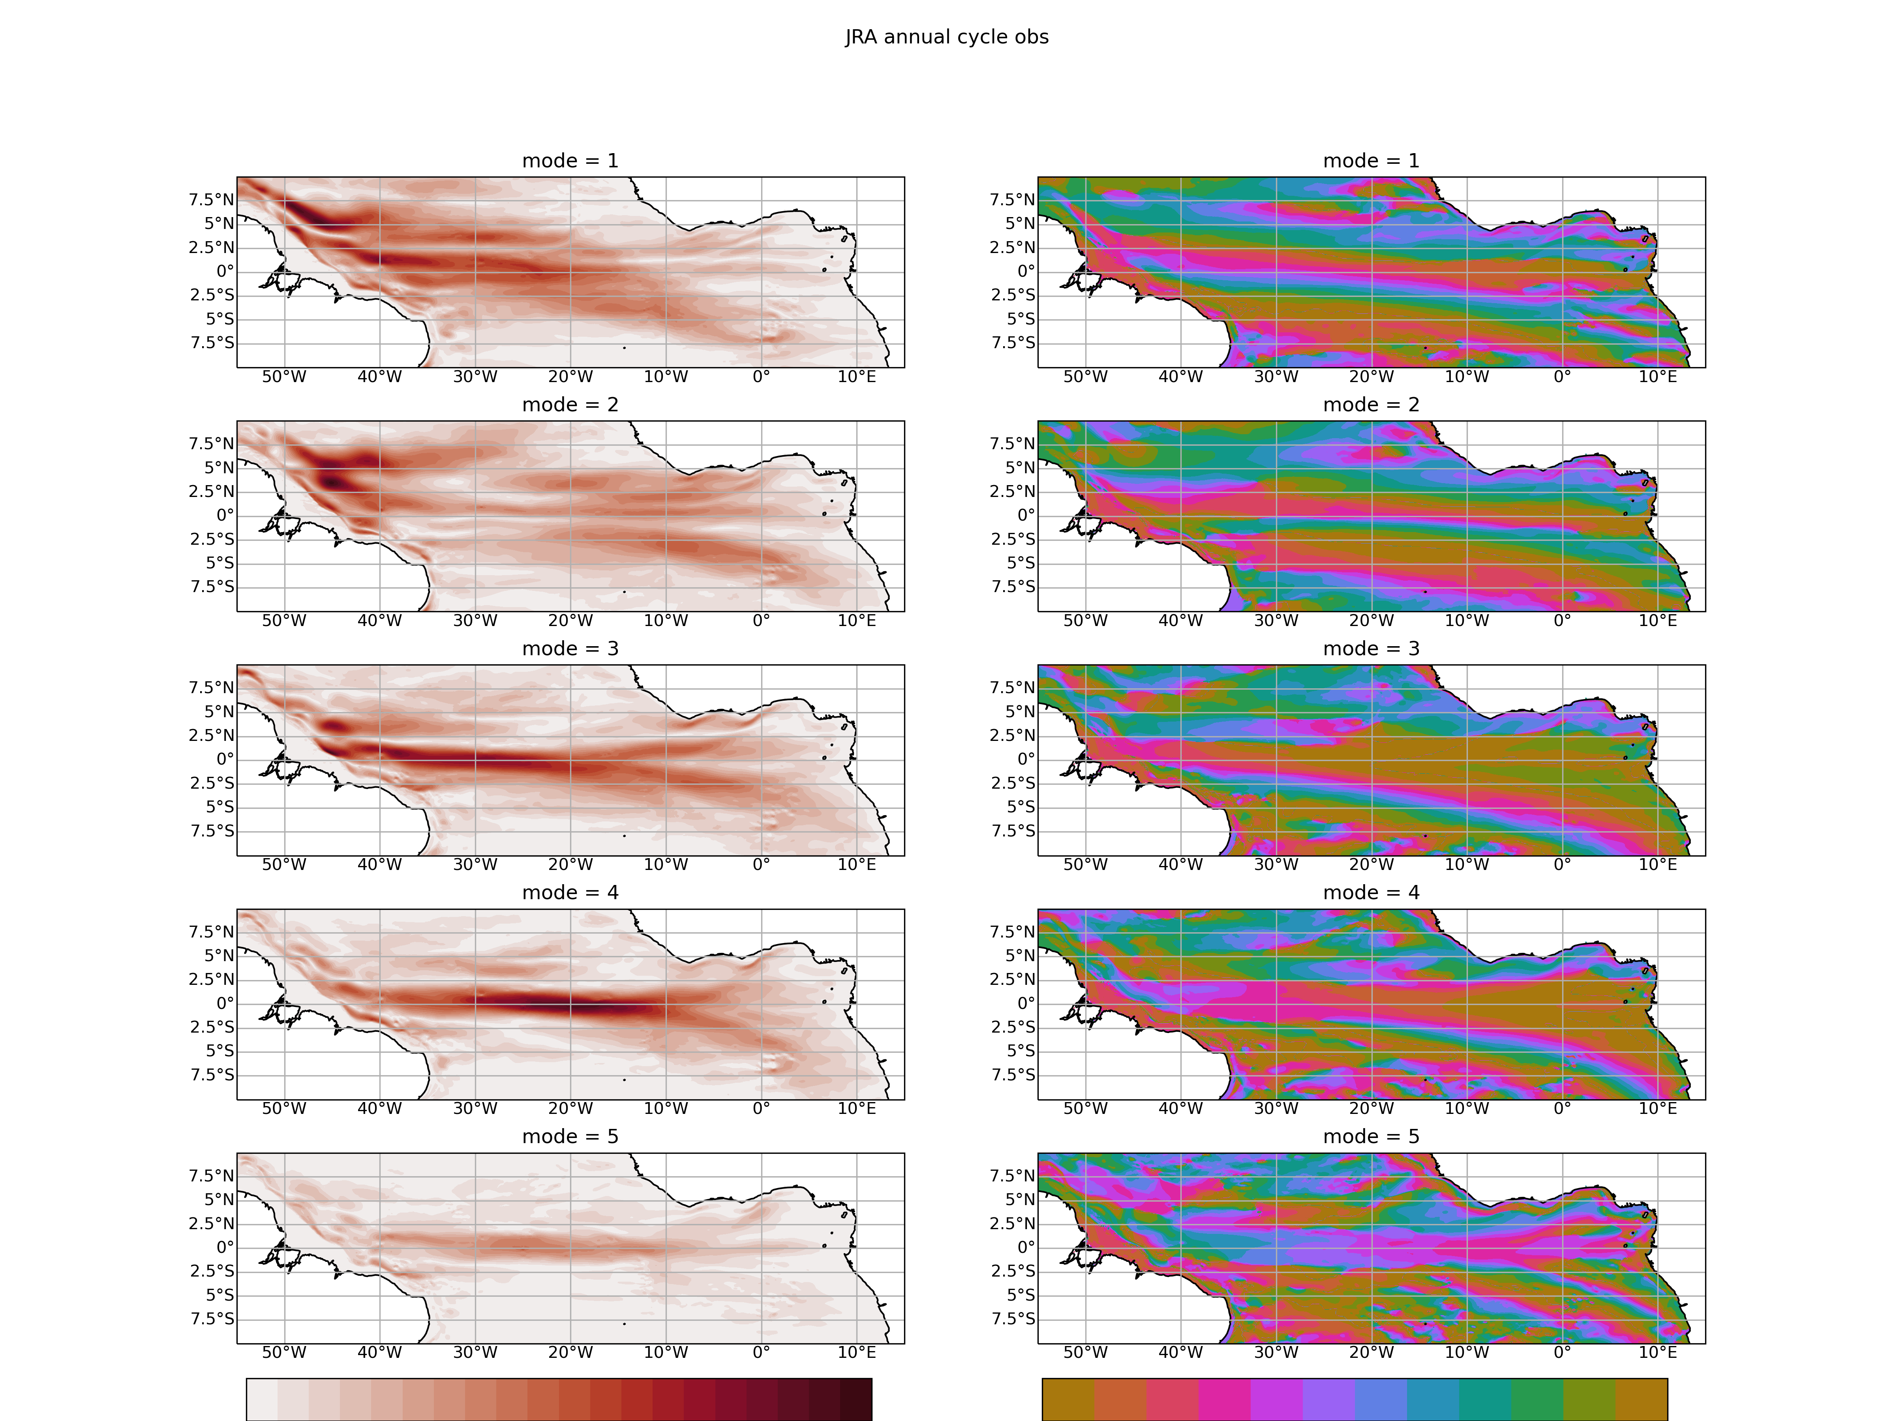
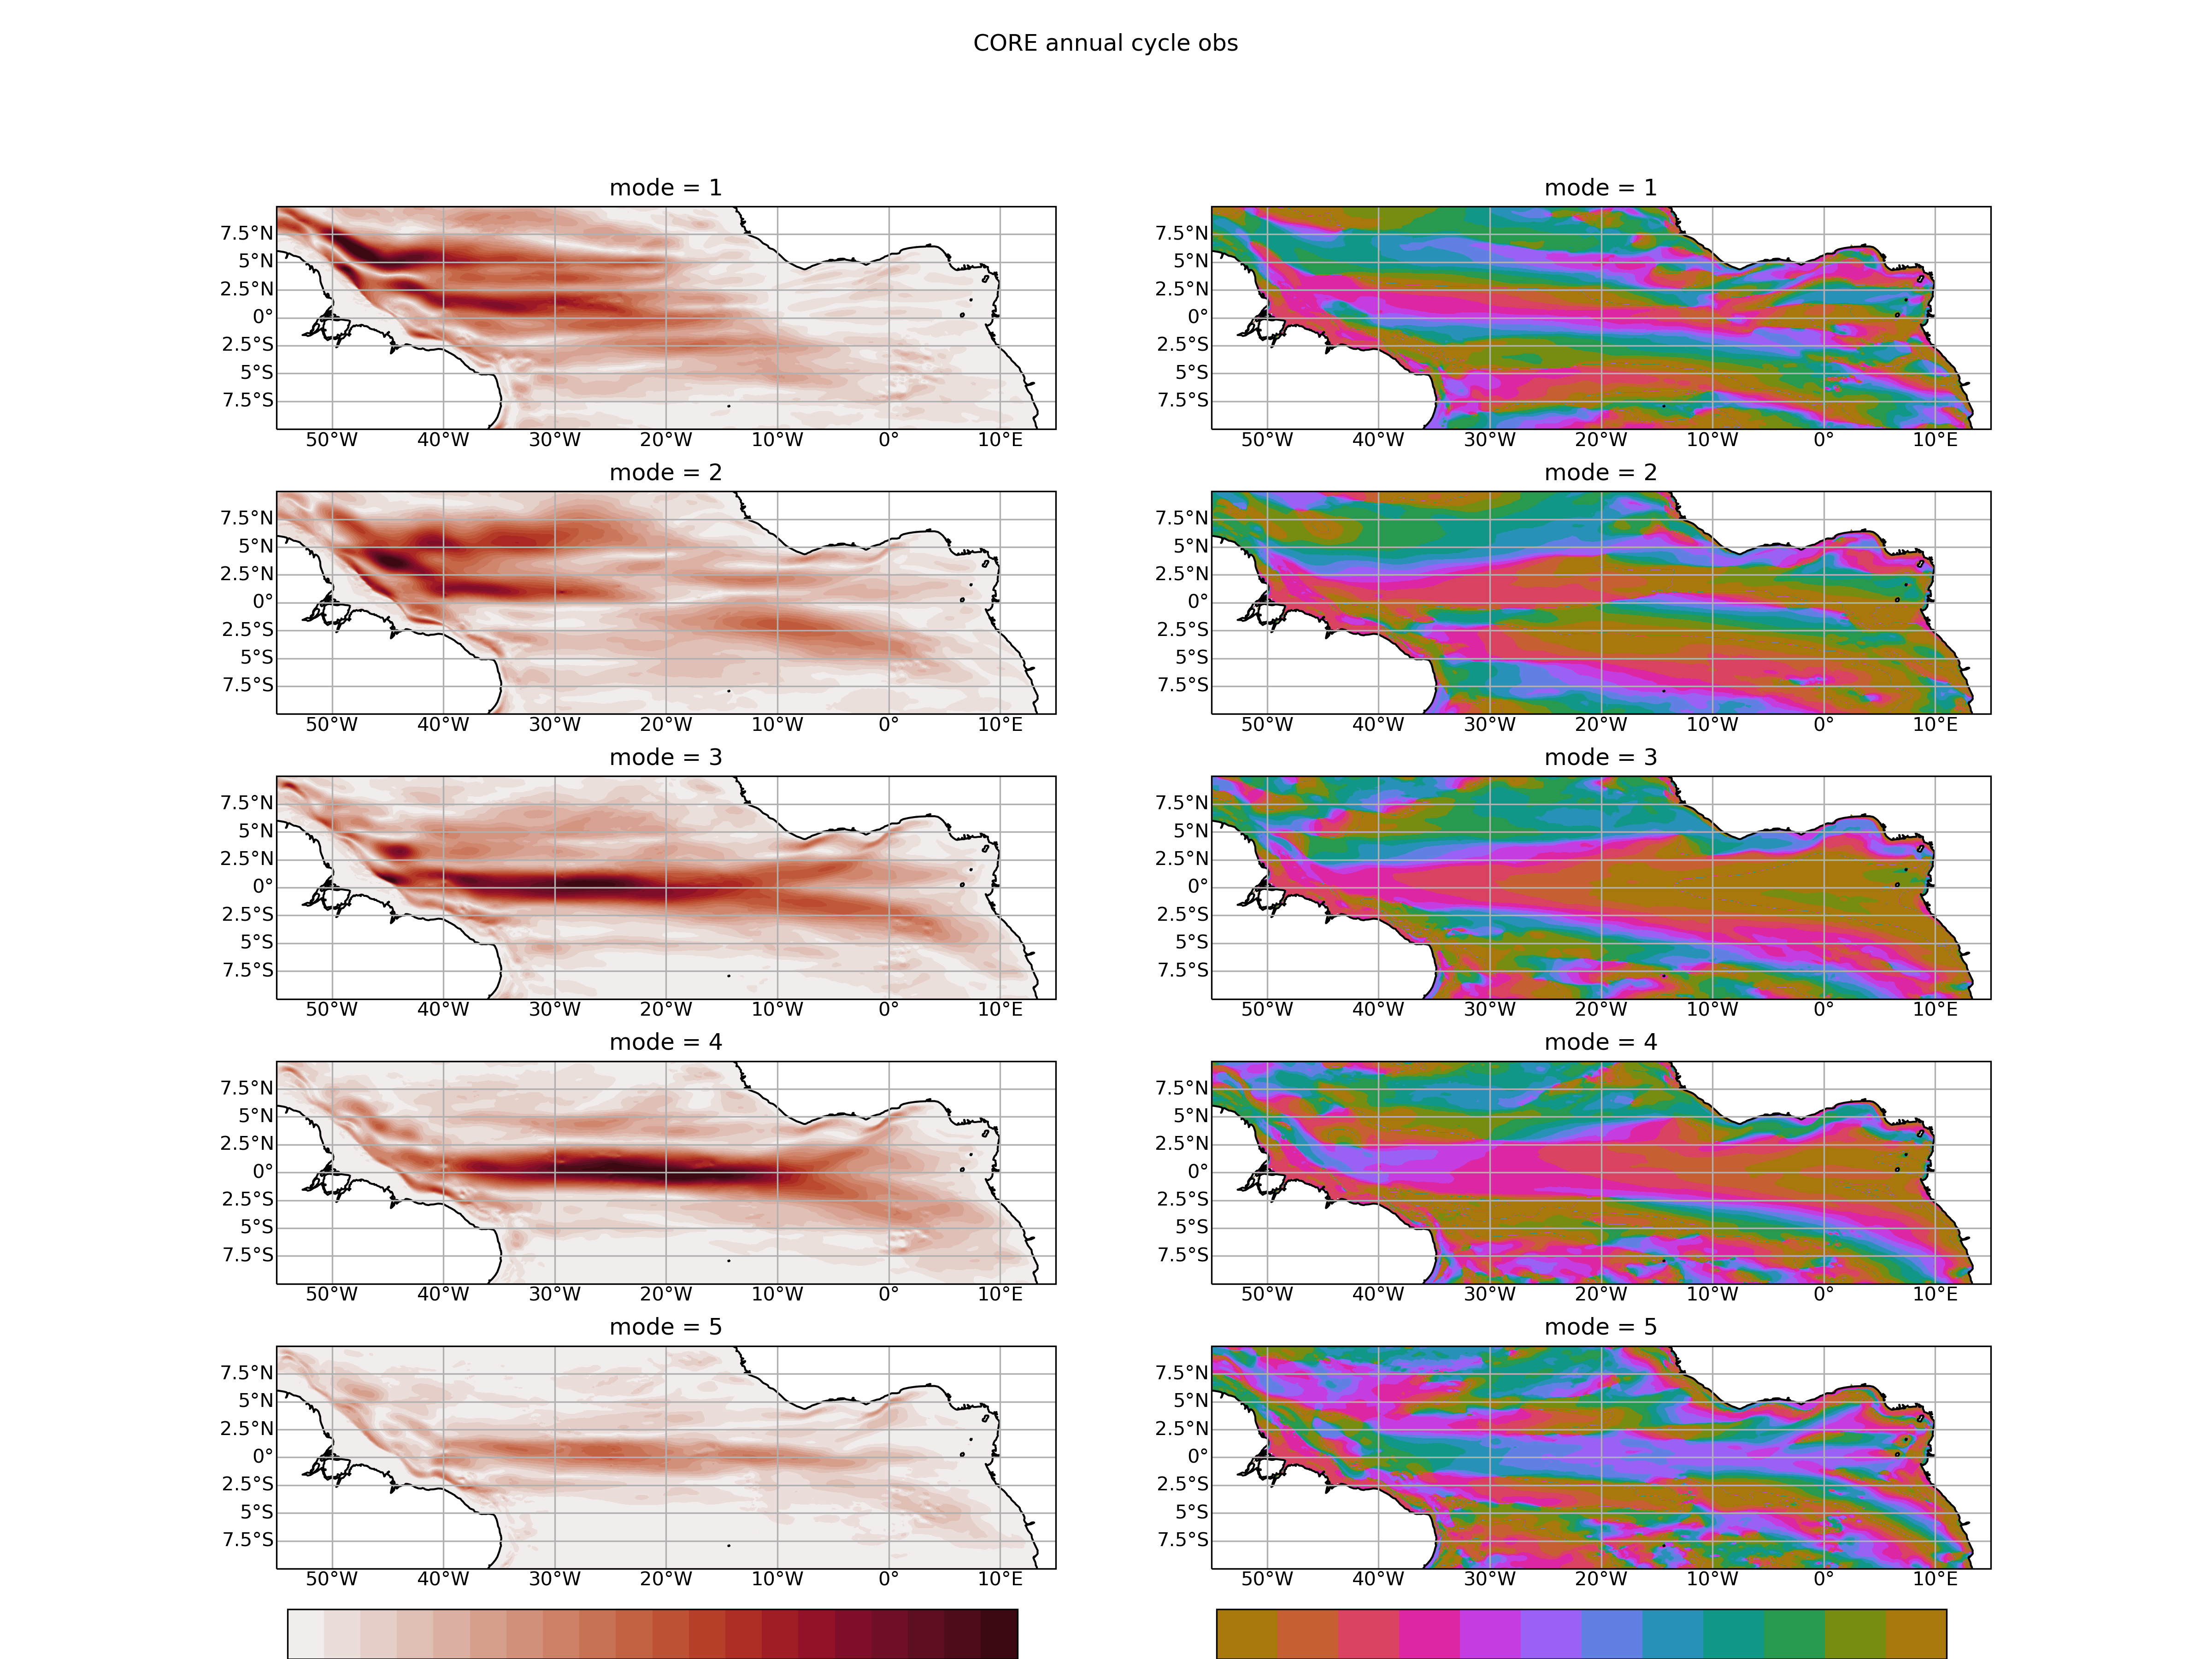
Annual 1980 - 2009
JRA
CORE
JRA
CORE

Slide 3
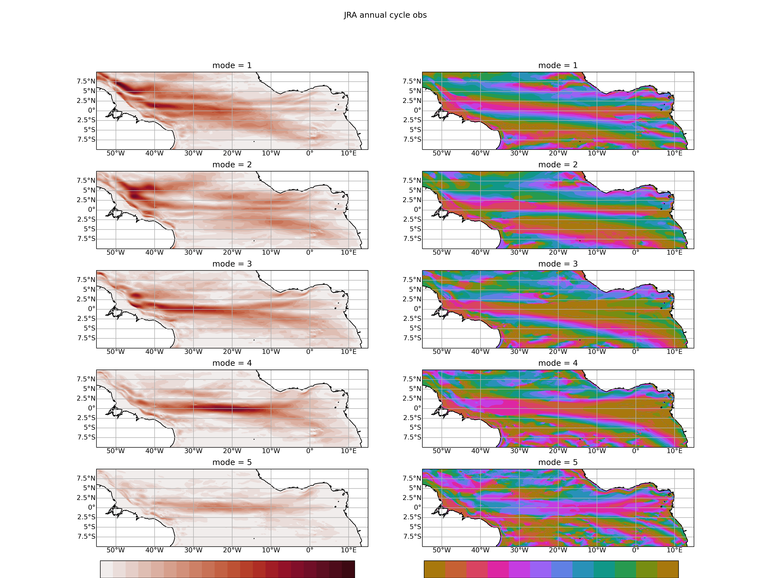
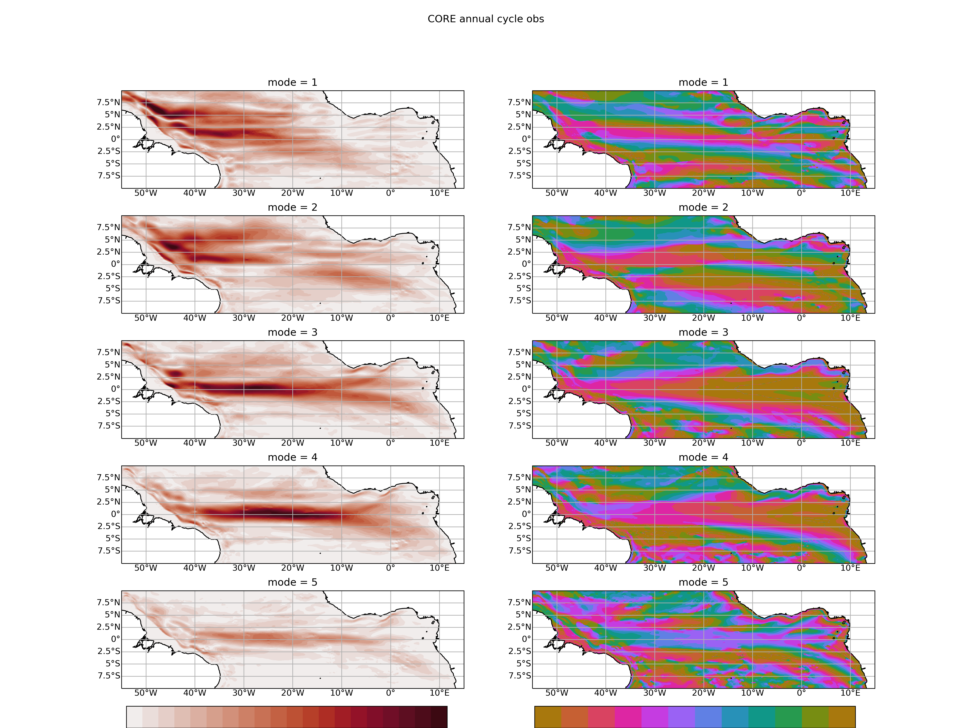
Annual 1991 - 2009
JRA
CORE
JRA
CORE

Slide 4

Annual 1991 – 2009 (CORE) and 2000-2018 (JRA)
JRA
CORE
JRA
CORE

Slide 5
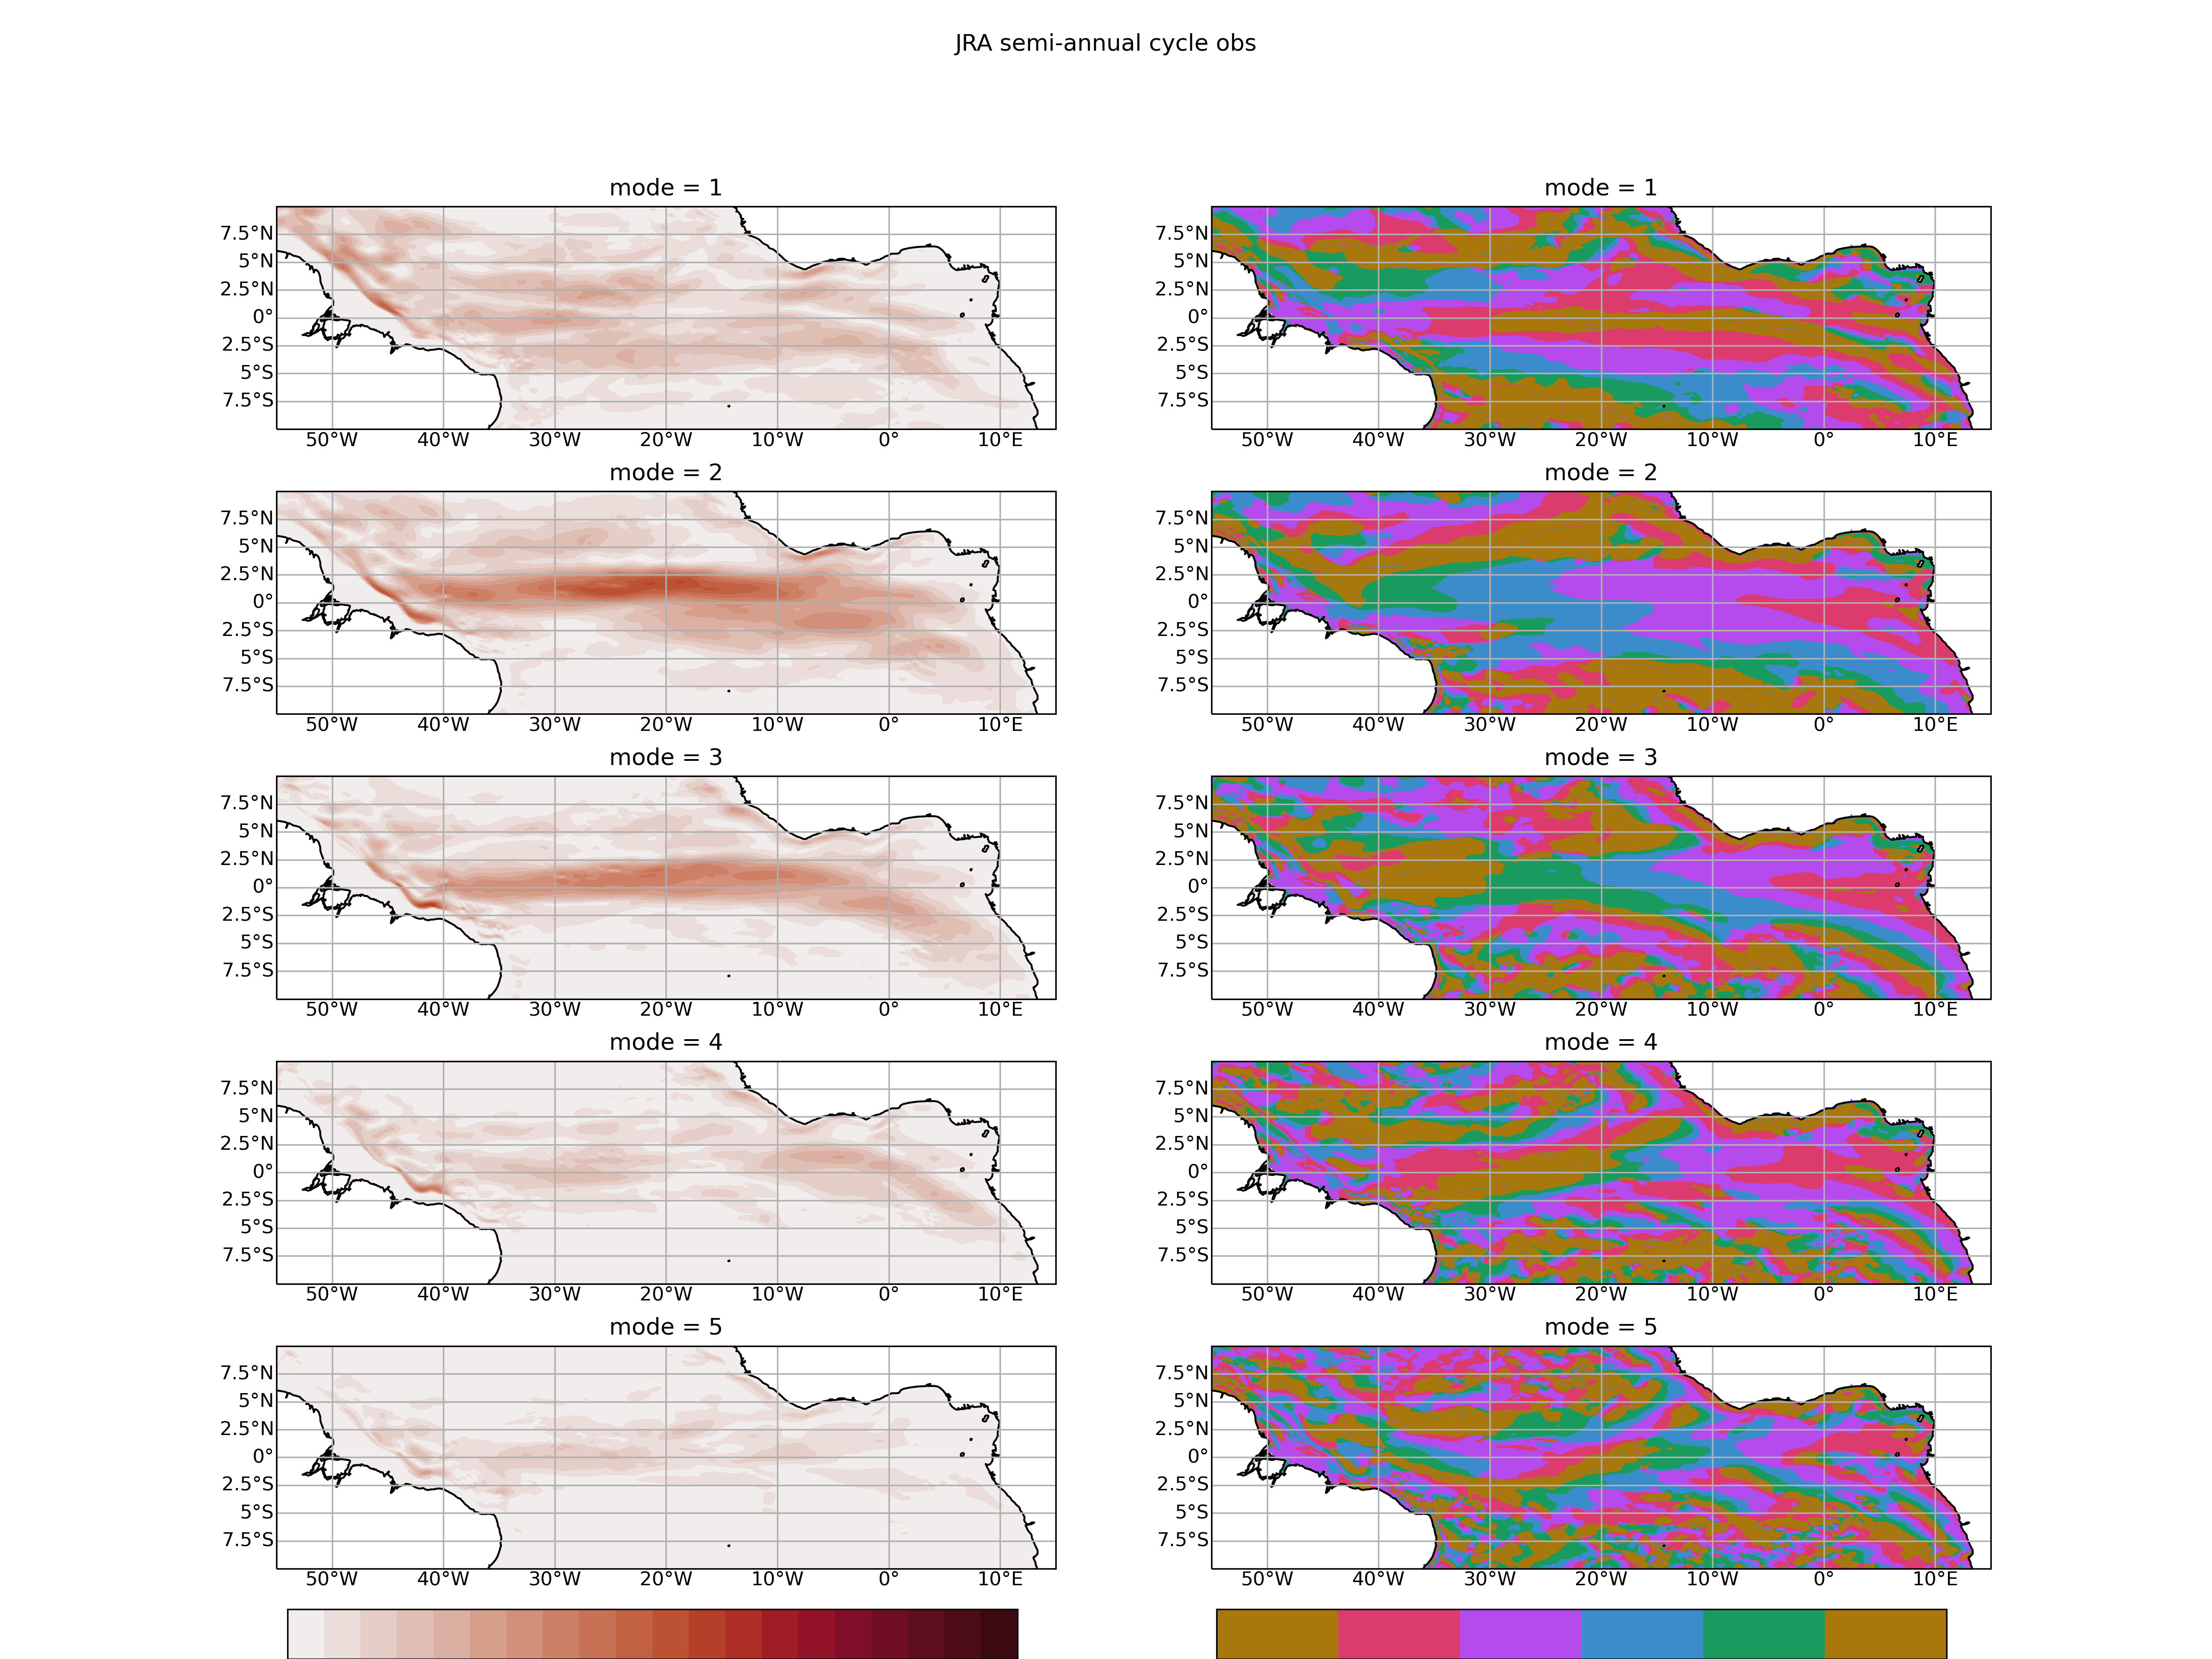
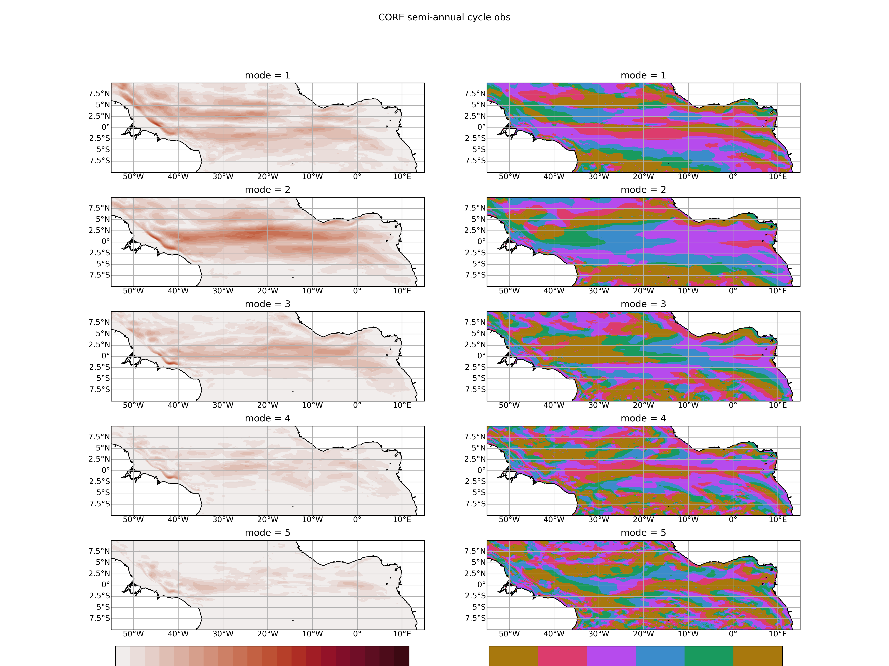
Semi-annual 1980-2009
JRA
CORE
JRA
CORE

Slide 6

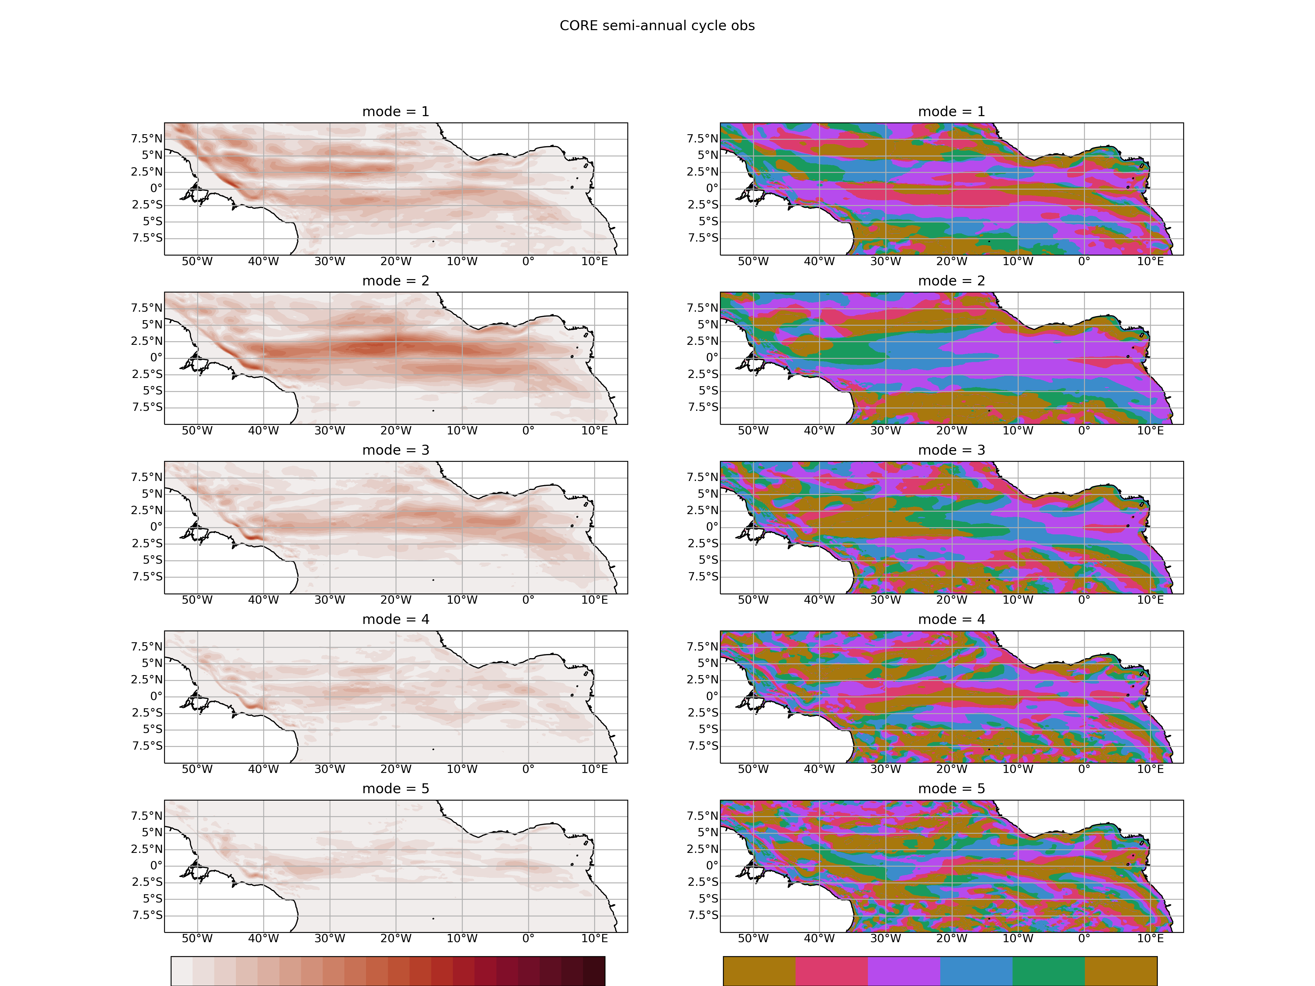
Semi-annual 1991-2009
JRA
CORE
JRA
CORE

Slide 7
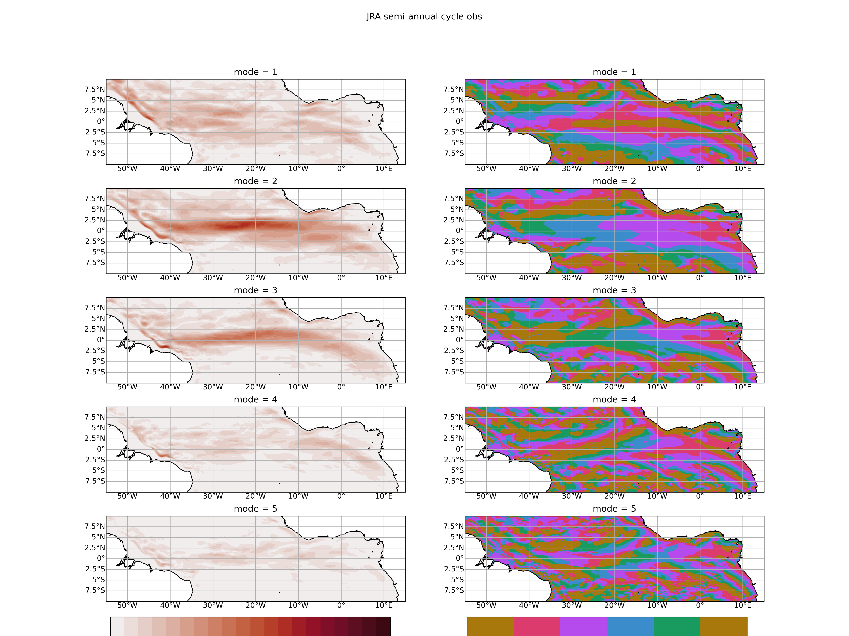
Semi-annual 1991-2009 (CORE); 2000-2018 (JRA)
JRA
CORE
JRA
CORE

